Slide 1
Class Based Modeling

Slide 3
Approaches for Identifying Classes
The noun phrase approach.
The common class patterns approach.
The class responsibilities collaboration (CRC) approach.
The use-case driven approach.

Slide 4
1. Noun-phrase approach
Initial list of noun phrases
Eliminate irrelevant classes
Reviewing redundant classes
Review adjective classes
Review possible attributes
Review the class purpose

Slide 5
Noun Phrase Strategy (Contd…)
Change all plurals to singular and make a list, which can then be divided into three categories.
1. Relevant classes
2. Fuzzy classes(class that are not sure about)
3. Irrelevant classes

Slide 6
1.1 Initial list of Noun phrases
Guidelines for identifying tentative classes
Look for nouns in the System Requirements Specification (SRS)
Some classes are implicit or taken from general knowledge
All classes are to be taken from problem domain
Carefully choose and define class names

Slide 7
1.2 Eliminate Irrelevant classes
Noun-phrase are put into 3 categories
Relevant classes
Fuzzy classes
Irrelevant classes - unnecessary, so omit

Slide 8
1.3 Reviewing Redundant classes
Redundant classes from Relevant and Fuzzy classes
Do not keep two classes that express the same information
In case of more than one to describe the same idea, choose the word used by user of the system

Slide 9
1.4 Review Adjective classes
Adjectives are used in many ways
Adjectives can suggest a different kind of object
Different use of the same object
Find whether the object represented by noun behave differently when the adjective is applied to it.
Make a new class only if the behavior is different

Slide 10
1.5 Review possible Attributes
Attribute classes
Classes defined only as values should be restated as attributes and not classes

Slide 11
1.6 Review the class purpose
Each class must have a purpose and every class should be clearly defined.
Formulate a statement of purpose for each candidate class.
Otherwise, eliminate the candidate class

Slide 12
Guidelines For Identifying Classes
The followings are guidelines for selecting classes in your application:
Look for nouns and noun phrases in the problem statement.
Some classes are implicit or taken from general knowledge.
All classes must make sense in the application domain.
Avoid computer implementation classes, defer it to the design stage.
Carefully choose and define class names.

Slide 13
Guidelines For Identifying Classes (Contd…)
External Entities (e.g. other systems, devices, people)
Things (e.g. reports, displays, letters, signals, results)
Occurrences or Events (e.g. property transfer, fund transfer, robot movements)
Roles (e.g. manager, engineer, salesperson)
Organizational Units (e.g. division, group, team)
Places (e.g. manufacturing floor, loading dock, back door)
Structures (e.g. sensors, vehicles, computers)
Not Objects/Attributes (e.g. number, type)
1. Identify potential classes and define above attributes based on above mentioned points.
2. Then apply selection characteristics to retain with potential classes.

Slide 14
Selection characteristics of Potential Classes
Retained Information: information about class must be remembered so that the system should function.
Needed Services: must have set of identifiable operations that can change the value of attributes in some way.
Multiple Attributes: multiple attributes should be represented in the class
Common Attributes: set of common attributes can be defined or applied to all instances of that class.
Common Operations: set of common operations can be defined or applied to all instances of that class.
Essential Requirements: information producing or consuming by external entities should be considered as classes

Slide 15
Guidelines For Refining Classes
Redundant Classes:
Do not keep two classes that express the same information.
If more than one word is being used to describe the same idea, select the one that is the most meaningful in the context of the system.

Slide 16

Guidelines For Refining Classes (Contd..)
Adjective Classes:
Does the object represented by the noun behave differently when the adjective is applied to it?
If the use of the adjective signals that the behavior of the object is different, then make a new class.
For example, If Adult Membership and Youth Membership behave differently, than they should be classified as different classes.

Slide 17
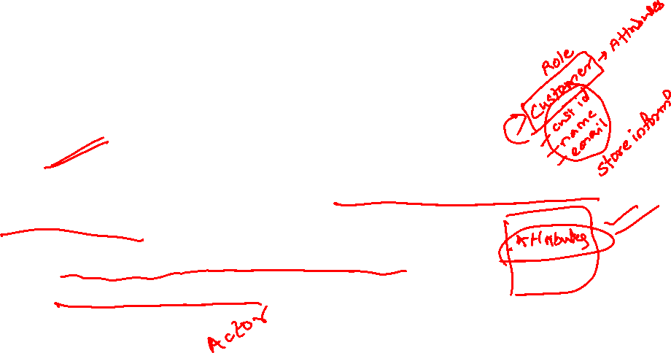
Guidelines For Refining Classes (Con’t)
Attribute Classes:
Tentative objects which are used only as values should be defined or restated as attributes and not as a class.
For example the demographics of Membership are not classes but attributes of the Membership class.

Slide 18
Guidelines For Refining Classes (Con’t)
Irrelevant Classes:
Each class must have a purpose and every class should be clearly defined and necessary.
If you cannot come up with a statement of purpose, simply eliminate the candidate class.

Slide 19
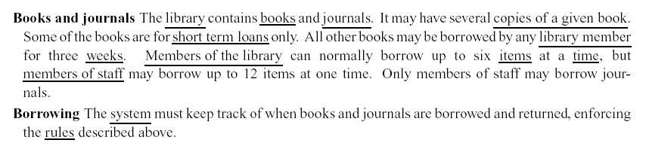
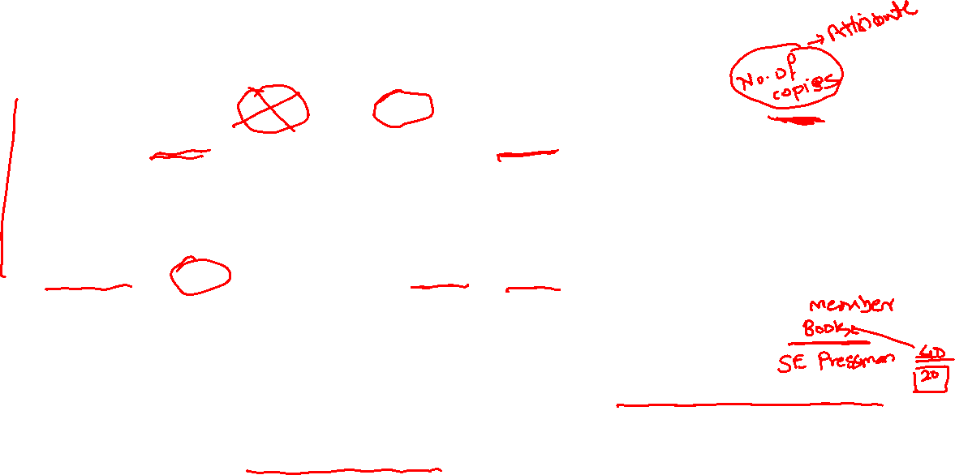
Identifying a list of candidate classes: Example 1
Take a coherent, concise statement of the requirement of the system
Underline its noun and noun phrases, that is, identify the words and phases the denote things
This gives a list of candidate classes, which we can then whittle down and modify to get an initial class list for the system

Slide 20

In this particular case we discard
Library, because it is outside the scope of our system
Short term loan, because a loan is really an event, which so far as we know is not a useful object in this system
Member of the library, which is redundant
Week, because it is a measure, not a thing
Item, because it is vague (we need to clarify it)
Time, because it is outside the scope of the system
System, because it is part of the meta-language of requirements description, not a part of domain
Rule, for the same reason

Slide 21
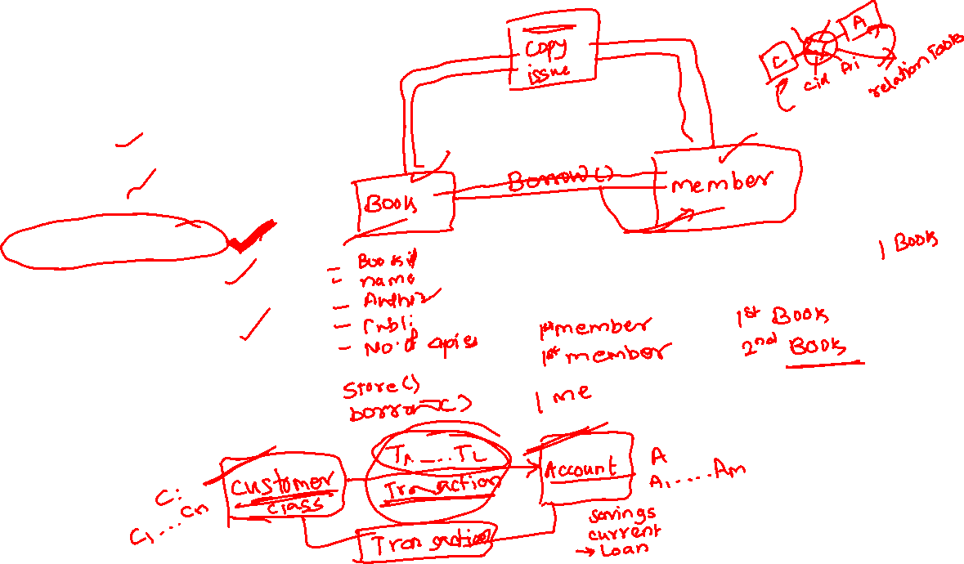
This leaves:
Book
Journal
Copy (of book)
Library member
Member of staff

Slide 22
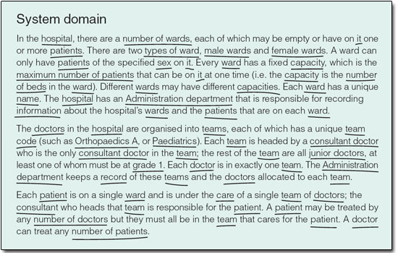

Example 2:

Slide 23
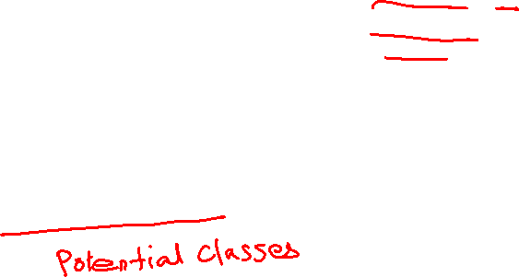
hospital
number of wards
patient
type of ward
male ward
female ward
ward
sex
capacity (maximum number of patients, number of beds)
name of ward
Administration department
information
doctor
team
team code
Orthopaedics A
Paediatrics
grade 1
consultant doctor (consultant)
junior doctor
record of teams and doctors
care
number of doctors
number of patients

Slide 24

Eliminated Classes
hospital, Administration department (outside the scope of the system)
number of wards (language idiom – the requirements document could equally well have referred to ‘wards’ or ‘some wards’)
type, capacity, name (attributes of ward)
sex (attribute of patient)
information (generic term referring to the behaviour of the system)
team code (attribute of team)
record of teams and doctors (part of the behaviour required of the system)
number of doctors, number of patients (language idiom)

Slide 25
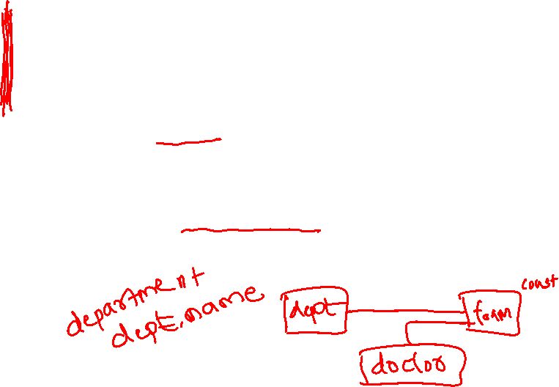
You may have noticed that there are three nouns,
‘Orthopaedics A,
‘Paediatrics’ and
‘grade 1’,
which have not been eliminated using the guidelines for rejection, yet which common sense suggests should not be modelled by classes.
‘Orthopaedics A and ‘Paediatrics’ are in fact given in the requirements document as example values of ‘team code’, which was identified above as an attribute of team, and ‘grade 1’ is a value of an attribute, ‘grade’, of junior doctor.

Slide 26
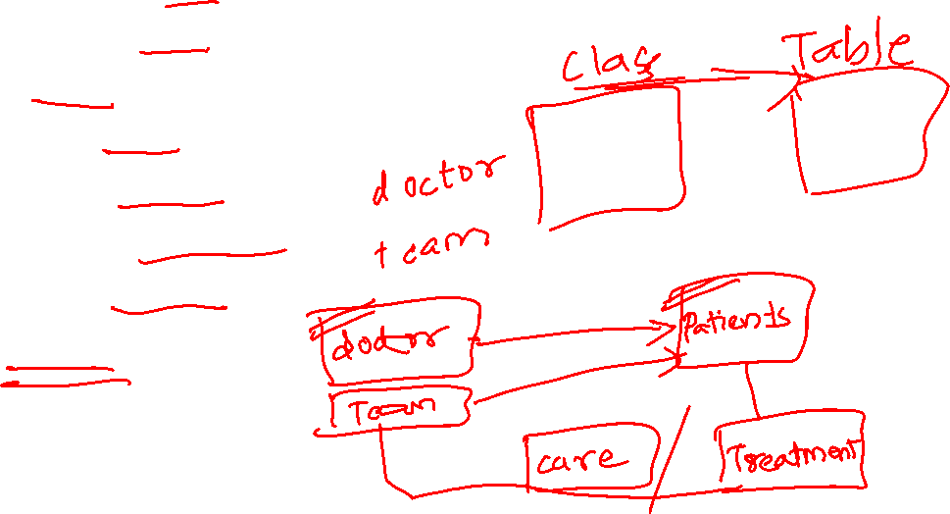
male ward
female ward
ward
patient
doctor team
consultant doctor
junior doctor
care

Slide 27
Example 3:
A store wants to automate its inventory. It has point-of-sale terminals that can record all of the items and quantities that a customer purchases. Another terminal is also available for the customer service desk to handle returns. It has a similar terminal in the loading dock to handle arriving shipments from suppliers. The meat department and produce department have terminals to enter losses/discounts due to spoilage.

Slide 28
Identify nouns
Store
Inventory
Point-of-sale terminal
Terminals
Items
Quantity
Purchase
Customer
Customer service desk
Handle returns
Returns
Loading dock
Shipment
Handle shipment
Suppliers
Meat department
Produce department
Department
Enter losses
Enter discount
Spoilage

Slide 29
Eliminate irrelevant nouns
Store
Point-of-sale terminal
inventory
Item
Customer
Customer service desk
Handle returns
Returns
Handle shipment
Shipment
Meat department
Produce department
Department
Enter losses
Enter discount

Slide 30
Eliminate redundancies
Store
Point-of-sale terminal
Item
Customer service desk
Handle returns
Handle shipment
Meat department
Produce department
Enter losses
Enter discount

Slide 31
The final set of classes and objects after the elimination process.
Point-of-sale terminal
Item
Handling return
Handling shipment
Enter losses
Enter discount
Meat department
Produce department
Store

Slide 32
2. Common Class patterns approach
Based on a knowledge base of the common classes proposed by various researchers
Concept class
Event class
Organization class
People class
Place class
Tangible things and device class
Review the class purpose

Slide 33
2.1 Concept Class
Idea or understanding of the problem
Principles tbhat are not tangible, and used to organize or keeping track of business activities
E.g.: Performance, reservation

Slide 34
2.2 Event class
Things happen at a given date and time
Points in time that must be recorded
E.g.: Request, order

Slide 35
2.3 Organization class
A collection of people, resources, facilities, or group to which the users belong
E.g.: Accounting department

Slide 36
2.4 People class (roles class)
Different roles users play in interacting with application
Guideline
Classes that represent users of the system
E.g.: Operator, clerk
Classes representing people who do not use the system but about whom information is kept by the system
E.g.: Employee, client, teacher, manager

Slide 37
2.5 Places class
Areas set aside for people or things
Physical locations that the system must keep information about
E.g.: Building, store, site, travel office

Slide 38
2.6 Tangible things
Physical objects or groups of objects that are tangible and devices with which application interacts
E.g.: Car, ATM

Slide 39
ATM Case Study –System Requirements
The bank client must be able to deposit an amount to and withdraw an amount from his or her accounts using the touch screen at the ATM kiosk. Each transaction must be recorded, and the client must be able to review all transactions performed against a given account. Recorded transactions must include the date, time, transaction type, amount and account balance after the transaction
A bank client can have two types of accounts: a checking account and savings account. For each checking account, one related savings account can exist.
Access to the bank accounts is provided by a PIN code consisting of four integer digits between 0 and 9

Slide 40
ATM Case Study –System Requirements
One PIN code allows access to all accounts held by a bank client
No receipts will be provided for any account transactions
The bank application operates for a single banking institution only
Neither a checking nor a savings account can have a negative balance. The system should automatically with draw money from a related savings account if the requested withdrawal amount on the checking account is more than its current balance. If the balance on a savings account is less than the withdrawal amount requested, the transaction will stop and the bank client will be notified.

Slide 41
Apply Common Class patterns to ATM Case study
Concept class - Availability
Events class – Account, Checking account, Savings account, Transaction class
Organization class – Bank class
People class – BankClient class
Places class – Building
Tangible things and devices class – ATM Kiosk

Slide 42
Guidelines for Naming Classes
The class should describe a single object, so it should be the singular form of noun.
Use names that the users are comfortable with.
The name of a class should reflect its intrinsic nature.

Slide 43
Guidelines for Naming Classes (Con’t)
By the convention, the class name must begin with an upper case letter.
For compound words, capitalize the first letter of each word - for example, LoanWindow.

Slide 44
Summary
Finding classes is not easy.
The more practice you have, the better you get at identifying classes.
There is no such thing as the “right set of classes.”
Finding classes is an incremental and iterative process.

